Slide 1
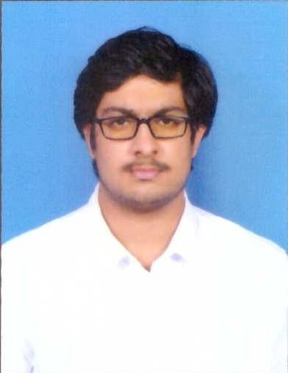


Babbellapati Dutta Sai Kiran
Analyst/Software Engineer
Bachelor of Engineering
Computer Science : 2018 - 2022
Skills
Node JS
Express JS
Spring Core
Spring Boot
Spring MVC
Core java
MERN Stack
ReactJS
NodeJS
MongoDB
Database
No SQL database – MongoDB
Web Technologies
HTML5
CSS3
Javascript
AddOns
Github
Maven
Postman
Additional Details
Leadership
Excellent Communication Skills
Team management
Mumbai
BABBELLAPATI-DUTTA.SAI-KIRAN@CAPGEMINI.COM
+91 6305302905
A4
Software Engineer who is Strong in design and integration with intuitive problem-solving skills. Passionate about implementing and launching new projects.
Ready to learn new technologies and implement them to further improve my knowledge.
Eager to work in a team of dedicated people and serve a key role in the enhancement and development of the project.
Has good hands-on in node JS, express JS and REST API, and serverless application building using AWS.
Has working knowledge on spring framework, microservices, API gateway, eureka server, ReactJS on an intermediate level.
Online Railway reservation Application
Completed end to end case study of Online railway reservation Application along with JWT authentication, API gateway, Swagger and implemented microservice architecture and eureka registry. React is used for user interface.
AWS Certified Cloud Practitioner
Certified in AWS cloud practitioner.
Completed Java Full Stack training in ADAPT.
Completed Java Full Stack and received internship completion letter from Capgemini. Done case study using technology stack learnt in training.
Check out my work on GitHub

